Slide 1
Field Representatives Promotion Potential Opportunities Discrimination
Field GS promotion standard policies being used in 2023 appears to purposefully discriminate against workers who live in areas where employment opportunities are limited and disproportionally affects women, workers over 40, and workforce who are more likely to live in demographically designated white areas. Possible EEOC Title VII violation
Presented to U.S. Census Bureau, April 2023
by Monica Feffer NYRO FSA 7354

Slide 2
Census Mission
The Census Bureau's mission is to serve as the nation’s leading provider of quality data about its people and economy.
We honor privacy, protect confidentiality, share our expertise globally, and conduct our work openly.
We are guided on this mission by scientific objectivity, our strong and capable workforce, our devotion to research-based innovation, and our abiding commitment to our customers.
Message from the Director
We owe it to ourselves and to our nation to think broadly about how we can continue to make significant contributions to our society .
We will do so by embracing the highest level of scientific integrity and transparency, and by using our creativity and innovation by incorporating diverse perspectives.
- Robert L. Santos, Director, U .S . Census Bureau
https://www.census.gov/about/what/census-at-a-glance
#2

Slide 3
Same Hiring Bulletin. Same Job. Same Work Rules Three Different Promotion Opportunities by FSA*
New York Regional Office – duplicated around the nation.
Hired at promotion potential GS-5
7151, 7152, 7153, 7154, 7251, 7252, 7253, 7254, 7255,7351, 7352, 7353, 7652, 7653, 7654, 7655, 7656, 7657
Hired at GS-4 promotion potential to GS-5
Entire state of Connecticut 7551, 7552, 7553, 7554, 7555
7854, 7855,7856, 7857, 7858, 7859, 7860,7155, 7156
Hired at 4 and will always be a 4
All Maine, New Hampshire, Vermont, PR, New York above Tarrytown
7651, 7658, 7851, 7852, 7853, 7354,7355, 7451, 7452, 7453, 7454, 7455, 7456, 7457, 7458, 7459,
*Field Sortation Area aka Field Supervisor Area
#3

Slide 4
The Field Workforce (FR) Job Position Description
Identical Position Description
Identical Recruitment Bulletin
Identical Title and Responsibilities
Identical Goals and Deadlines
Identical Performance Measures
Substantially Same Hard-to-count Populations
#4

Slide 5
SAME JOB. DIFFERENT PROMOTION PROTENTIAL

Slide 6
NO ONE DISAGREES WITH ANYTHING JUST SAID.
LEGAL IS NOT ALWAYS FAIR.

Slide 7
Facts About Field FSA Employees in Lower GS Level Areas
Vast majority are women
Vast majority are over 40
Limited employment opportunities in area
Talented, Dedicated, Educated, Longevity
Representative of population they interview (CT state law)
Cannot apply to GS7 jobs based on service
#7

Slide 8
Facts About Field FSA Employees in Lower GS Level Areas
Vast majority are women
Vast majority are over 40
Limited employment opportunities in area
Talented, Dedicated, Educated, Longevity
Representative of population they interview (CT state law)
Cannot apply to GS7 jobs based on service
#8

Slide 9
Facts About Field FSA Employees in Higher GS Level Areas
Probably women
Probably more age diversity
Increased employment opportunities in area
Some retention issues
Representative of population they interview
Can apply to GS7 jobs based on 1-year of service
#9

Slide 10
History of Complaint
In 2021, I questioned why the GS grade Disparity. I was told this determination was based on areas that were considered “Hard-to-Count” (HTC).
May 31, 2022 using the statistics data from the 2020 Census*, I proved that almost all FSAs in the New York Regional Office (NYRO) should be considered HTC and employees in many HTC areas are being denied equal promotion/advancement opportunity.
On June 14, 2022, I indirectly received a response sent down the chain-of-commend backpedaled and changed the Hard-to-Count policy and added different reasons.
The words on the email message from (Alyson Matti) stated “The process for determining grade levels for the Field Supervisors (FSs) is based on the grade levels of the Field Representatives (FRs) that work within the Field Supervisor Area (FSA). In 2018 Field Division Senior Management reviewed the grade levels of the FRs at the FSA level to account for their current grade (as of 2017), hard-to-enumerate areas, prevailing wages, retention, and planned Decennial pay rates from 2017, which resulted in the current Field grade structure.
On June 16, 2022 I sent back an email through to my supervisor requesting information on the prevailing wage statistics, retention statistics, and the determination on planned Decennial pay. I never received a response.
On February 13, 2023 I requested a meeting via my supervisor to their supervisor. Lance Sanchez There’s no money in the budget. My verbal response. This is not about money – it’s about promotion potential opportunity.
On February 27, 2023 received email to contact 301 763.4748. I called and they said to send email to call center HRD.call.center@Census.gov.
Friday, March 17, 2023 HRD call center called me to see if I wanted to file a complaint.
Crafting the legal strategy is problematic. 1. I’m not a lawyer. 2. If I win, I may end up losing my job. 3. To win I need to sleep with an enemy.
*CUNY Graduate Center - https://www.censushardtocountmaps2020.us
#10

Slide 11
Complaint
The Dept. of Commerce and US Census bureau is following a policy that was made in bad faith regarding Field worker GS Promotion Potential Opportunities. Decisions were made that are contrary and counter productive, opaque, and against inclusion, equity, diversity, and separately and together in violation of EEOC.
This complaint is not about pay or cost of living adjustments.
This complaint is about Promotion Potential Opportunities of all Field workers who were, are, and may be deny opportunities. This illegal policy was made in bad faith and substantially affect older workers who are over 40-years old and/or are female and who live in areas that are statistically older and white. This policy pinpointed areas that have fewer employment opportunities for experienced, over 40yo-workers and/or women who seek job flexibility. This is a clear violation of the rules that govern EEOC, Title 7, specifically disparate impact, when policies, practices, rules or other systems that appear to be neutral result in a disproportionate impact on a protected group.
This complaint is also about the GS Promotion Potential for employees who do substantially equal work and are refused equal promotion opportunities within the Federal Government because of the lower GS classification status.
I set out to prove current Field GS promotion levels are not grounded or justified in scientific objectivity, statistically based on hard-to-count areas, nor are they based on any logical, rational, equitable, fair or grounded in longevity of service, education attainment, quality of work, or language abilities.
#11

Slide 12
Classification Adjustment
This presentation is represent HTC facts that were not disputed, and responds to the new additional reasons that are claimed by Headquarters to justify inequality of GS levels:
Most FSA’s in NYRO are Hard-to-Count based on 2020 Census data.
Prevailing wages – This is not about wages.
Retention – Research Easily proved reasons with HBR.
Misguided policy that 2017 Decennial pay should play a role in establishing GS promotion for Field employment for ongoing surveys.
Decennial is a 10-question mandatory survey verses a voluntary survey with 6000 questions/paths, 1.5 hours, extensive financial, home, labor knowledge and 1000-page manual.
#12

Slide 13
Field Representative GS04/05 and GS06/07 Exact Same Job, Trainings, and Work Tasks with Different Grades & Promotion Potential
Description of recruitment bulletins are exactly the same
Performance review methods CD-430 are exactly the same.
Position Descriptions* mostly, exactly, and/or substantially the same. (see appendix) - 0303-04 SA5943 – FR - 0303-05 SA5843 – FR - 0303-06 SA9462 – FS - 0303-07 SA9666 – FS
Production deadlines and goals are substantially the same.
Training and refresher training requirements are exactly the same.
.
#13

Slide 14
Why GS Consistency is Important? OPM Classification Guidelines*
GS-4 Responsibility
Exercises initiative in completing recurring assignments; uses judgment in selecting appropriate guidelines and procedures from among a number of specific references.
GS-5 Responsibility Follows accepted practices in resolving non-recurring problems and meeting deadlines; completed products are evaluated for effectiveness in meeting goals; extensive guidelines in the form of instructions, manuals, and regulations are applied.
Policy data oversight: FRs who are GS-4s are not accountable to deadlines and goals! But the Census demands these goals and deadlines. The ramification of such a policy is counterproductive to the mission of the Census.
*https://www.opm.gov/policy-data-oversight/classification-qualifications/classifying-general-schedule-positions/functional-guides/gscler.pdf

Slide 15
Hypothesis
What does the HTC data, retention rates, prevailing wages, Decennial pay, inform us about GS Field Promotion levels?
Is the Census Bureau using different GS promotion levels for employees who work full-time surveys, reasonable, equitable, based in scientific objectivity, and supported by HTC data, retention rates, prevailing wages, Decennial wages, or is the Census Bureau taking advantage of employees because they can. Vast majority are over 40 and/or female.
Does the Field GS promotion potential based on an arbitrary and capricious policy that determined Field levels grounded in unfounded causation in keeping with scientific integrity and transparency mission of the Census Bureau?
Causation explicitly applies to cases where action A causes outcome B

Slide 16
GS General-Schedule
The General Schedule has 15 grades; GS-1 (lowest) to GS-15 (highest).
Agencies establish (classify) the grade of each job based on the level of difficulty, responsibility, and qualifications required.
Those with a Bachelor’s degree for GS-5 positions (or one year of service at GS4) and those with a Master’s degree for GS-9 positions.
https://www.opm.gov/policy-data-oversight/pay-leave/pay-systems/general-schedule/

Slide 17
Identifying Successful Field Employees Working Full-Time surveys
The majority of successful FR Census employees:
1+ years working a Full-Time Census Survey, up to 2600 question voluntary survey.
Are knowledgeable and can communicate comfortably with with all populations.
Can convince randomly selected respondents to answer personal questions.
Can explain financial information and field important questions.
Are comfortable reading from a screen verbatim with poorly-worded questions
Have the same computer and typing skills as everyone in HQ. And can easily work in a technical and tech environment.
Believe in the work they do and Census Mission.
Strong work ethic.
Over the age of 40-years and/or female. disparate impact
https://www.opm.gov/policy-data-oversight/pay-leave/pay-systems/general-schedule/

Slide 18
What is Hard To Count (HTC)?
A Census tract is considered Hard-to-Count (HTC) if its Self-Response Rate in the Decennial Census was 73% or less.
Low self-response rate = Hard To Count (HTC)

Slide 19
Identifying Hard To Count (HTC)
Young Children
Complex Households
Anti-government
Short-term renters
Migrants
Minorities
Dense urban areas
Informal settlements
Remote and rural
Homelessness
Disasters
Institutions
Seafarers and fishers
Nomadic and transitory
Age, languages, and disabilities
Untraditional addresses and seasonal vacancies
Sparsely settled areas of Alaska and Maine
Only accessible by small plane, off-road vehicles, dogsleds
https://www.unfpa.org/sites/default/files/resource-pdf/Hard-to-Count-Populations-Brief.pdf /

Slide 20
What does the actual HTC data from the 2020 Census reveal?
HTC was not refuted by HQ

Slide 21
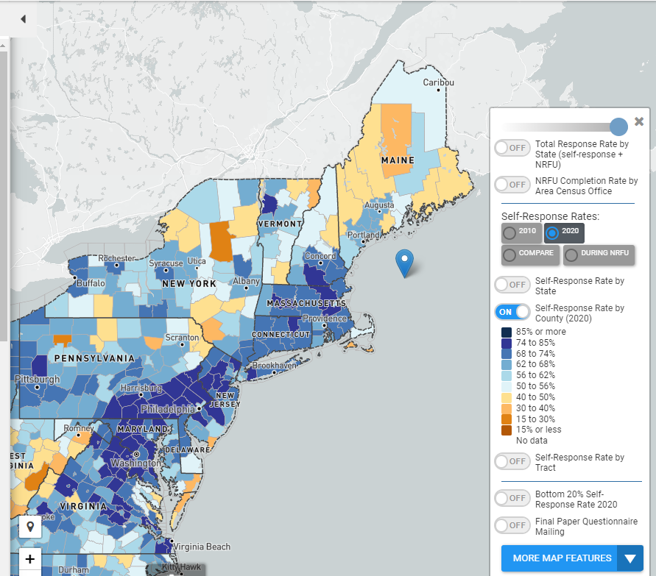
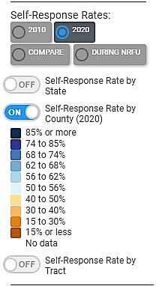
Visualization of 2020 Self-Response Rates of NYRO by County
HTC = lighter blues, whites and all shades of orange
The darker the blue the higher the self-response rate. Not HTC.
Light Blue, White, Shades of orange represent a low self- response rate. Yes HTC.
Lowest Response Rates are HTC
Maine
Upstate NY
Vermont
Those areas are all
mislabeled with GS-4 promotion status
https://www.censushardtocountmaps2020.us

Slide 22
HTC = Lighter Blues, Whites and Shades of Orange
Lowest Response Rates are HTC
Light Blue, White, and
shades of Orange
-Maine
-Upstate New York
-Vermont
Those areas are clearly
mislabeled as GS-4
Census website documents
mention Maine as HTC yet
Maine FRs are GS4!
https://www.censushardtocountmaps2020.us

Slide 23
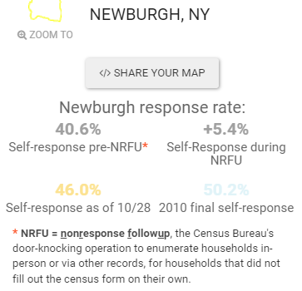
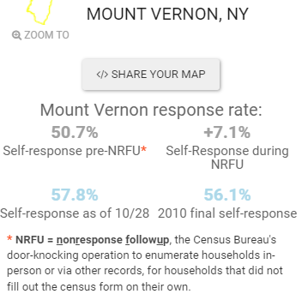
Sample HTC City Comparison
Forever GS-4 FSA 7354 Hired at GS-5 FSA 7353
https://www.censushardtocountmaps2020.us

Slide 24
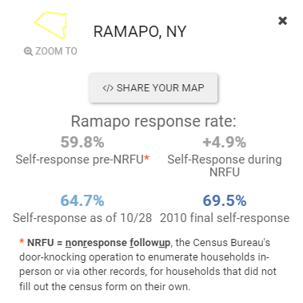
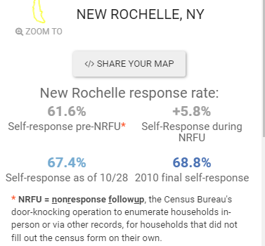
Sample HTC City Comparison
Pop. 111,000 (GS-4) Pop. 79,000 (GS-5)
https://www.censushardtocountmaps2020.us

Slide 25
Debunking Item 1 – HTC
Census Statistical data indicates that almost all FSAs in the NYRO are HTC (Language, Reservations, Anti Gov. Cultural issues)
Having the same position/job with a lower Grade Levels hinders opportunity of an employee seeking a position for another job within the Federal Government.
A GS4 cannot apply for a GS7 job Whereas, a GS5 with 1 year of service can apply for a GS7 position.
Item 1 - HTC was not refuted by NYRO or HQ

Slide 26
Debunking Item 2 – Using Decennial Pay To Determine GS is Misguided
The Decennial is a mandatory 10-question survey.
Ongoing voluntary surveys collecting data for the CPI (CE), Employment (CPS ASEC), Crime (NCS), Nation’s Health (NHIS) are voluntary surveys and have up to 3,000 computer pages of questions and may require the FR to interview everyone in the household taking up to 2-hours or more.
Conclusion – Ongoing voluntary surveys with 3000 questions are substantially more difficult than a 10-question mandatory decennial survey. Long-term FRs are professional employees who are reviewed yearly based on response rates and goals.
Decennial Pay was added when HTC was disputed.

Slide 27
Debunking Item 3 – Retention Theory
Retaining, training, and managing FRs is an art.
Give them a sense of purpose, community, it’s not about 1- GS level.
Most FRs who are successful and stay are over 40 and/or female and have fewer work options. The Census created policies that exploited this protected class.
Retention in all areas has to do with many factors including the quality of employees who need purposeful and flexible employment such as workers of 40 and/ traditional female roles.
Temporary Surveys such as AHS and SIPP – 80% of the response rate was completed by 20% of FRs who had ongoing survey experience and/or experience with interviewing.
https://hbr.org/2021/10/to-retain-employees-give-them-a-sense-of-purpose-and-community

Slide 28
Debunking 4 – Prevailing Wages
Prevailing wages can mean many things: An FR is part sales, interviewing, and computer savvy.
Average salary for Field Rep is $52K
Average salary for Sales Rep $52K
Average salary for Cold Calling $67K
Average salary for Interviewing Specialist $55,000
GS salary for FR GS4/02 with 3-years $38,773
Salary.com https://www.glassdoor.com/Salaries/interview-specialist-salary-SRCH_KO0,20.htm https://www.ziprecruiter.com/Salaries/Cold-Calling-Salary#:~:text=How%20much%20does%20a%20Cold,%2Fweek%20or%20%245%2C592%2Fmonth.

Slide 29
Conclusion
HTC - Census data indicates that almost all FSAs in NYRO are HTC.
Using Decennial pay to determine GS for ongoing surveys is misguided, irrelevant, and thoughtless data source.
Using retention rates is not scientific and just informs us of poor decision-making throughout the process and may conflict with protected class status.
Using prevailing wages for field sales workers and professional interviewers are much higher.
Salary.com https://www.glassdoor.com/Salaries/interview-specialist-salary-SRCH_KO0,20.htm https://www.ziprecruiter.com/Salaries/Cold-Calling-Salary

Slide 30
End note
The Census Field is not respected. I used to be in corporate branding and put together HR and branding programs to focus employees on the flavor of the business. IBM moving from hardware to consulting. American Express, Sprint, more. Census has transformation for the field. Let’s do something inspirational for the lowest level workers. What the Field wants in NYRO is to be respected. That respect is not having a chaste system that makes it impossible to be promoted.
Field Supervisors (GS6) recently participated in a meeting and were told by a GS-12+ that we could use their own money to give a small $10 gift card to FRs for good work. Let me know if you don’t see a problem with that and I’ll rewrite this presentation to include how inequality affects the way we think, live, treat one another, and the work we do. Yes, many in management are condescending in tone and manner to the field. Quotes like “we are in this together” when the grade-disparity is triple. Statisticians using Hot deck imputation will only get you so far until we realize the discrimination is perpetuated. And it is better to get quality data from FRs who garner trust from respondents.
Tapping into intellectual capital to make systems and procedures more efficient will enable us to collect better quality data at lower costs, keep job satisfaction high, and lower attrition rates For example: Why can’t an FR who works a survey and has an adjunct professor job teaching interviewing techniques to graduate students working on their thesis be allowed to teach a Survey Training Class?
Actual Field employees should have seats at the table when making decisions about the Field. GS-11+ and FRs often have similar management and life experiences. Be respectful of the Field for their professionalism and talents.

Slide 31
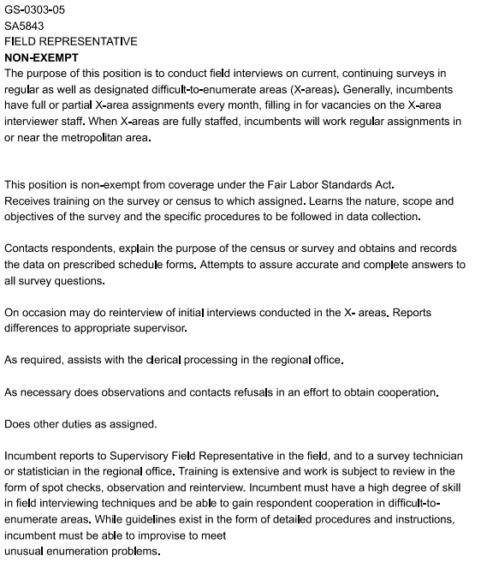
Appendix Side by Side GS4- GS5
S-0303-04
SA5943
FIELD REPRESENTATIVE
NON-EXEMPT
This position is located in the Regional Offices of Field Division which are responsible for the collection of a variety of data. The purpose of this position is to interview respondents to collect data as required on one or more current recurring surveys such as the Current Population Survey, National Crime Survey, Consumer Expenditure Survey, and as required on one-time surveys.
This position is covered by the overtime provisions of the Fair Labor Standards Act because it is identified with criteria for non exempt positions.
Attends classroom training sessions to review detailed survey procedures and techniques. Receives detailed training on revised or new survey procedures for each field operation to which assigned. Maintains personal payroll records which reflect hours worked, miles driven, and reimbursements for travel and communications claimed.
Payroll information is completed and submitted following instructions provided in administrative materials. Reports progress and costs as required by supervisor and assures that assignments are completed and transmitted to the regional office on time.
Receives and completes assignments which may include listing units at specific addresses, sub segmenting, and conducting interviews with respondents either by personal visit or by telephone. Explains the purpose of the survey, asking questions as worded on the survey forms, and recording data accurately and completely. Interviews are completed using sound interviewing and probing techniques learned in training and by applying a thorough understanding of survey objectives, detailed procedures and instructional manuals. Using established procedures, contacts refusal cases to persuade them to cooperate.
Completes reinterview and observation classroom training and/or self-study training to conduct reinterviews or observations of new interviewers. Reports results of these activities according to established procedures. The incumbent reports to a supervisory field representative, survey statistician, and/or other higher level employee. Training, particularly on new surveys is extensive and work is reviewed through observation an reinterview. The nature of the work requires a very high degree of independence in scheduling work hours and conducting interviews in an unstructured environment without close supervision.

Slide 32
Appendix Side by Side GS4- GS5- Continued
S-0303-04
SA5943
FIELD REPRESENTATIVE
NON-EXEMPT
Factor 1 - Knowledge Required by the Position - FL - 1-3 350 pts Knowledge of verbatim survey guides in order to conduct data collection surveys accurately. Ability to apply appropriate interviewing techniques to follow up on problems and/or to clarify questionable responses from respondents.
Factor 2 - Supervisory Controls - FL 2-2 125 pts The incumbent works under the supervision of a Field Supervisor. Routine work is done independently; judgment and initiative are required in solving problems. Difficult situations are referred to the supervisor for resolution. Work is reviewed according to whether or not it meets Bureau deadlines and quality standards.
Factor 3 - Guidelines - FL 3.2 125pts Guidelines include verbatim survey scripts, survey manuals and directives, Field Division policy memoranda from headquarters, and any internal polices and procedures established by the Regional Office. The employees solves problems by applying guidelines. Exceptional cases are referred to the supervisor.
Factor 4 - Complexity - FL 4-2 75pts Incumbent provides all clerical support required for conducting data collection activities in a regional office and provides assistance to the field supervisor. The incumbent must be able to determine and apply best solution to a variety of problems.
Factor 5 - Scope and Effect - FL 5-2 75 pts. The purpose of the work is to support the Regional Office's data collection activities. This work contributes to the overall efficiency of the Bureau.
Factor 6 - Personal Contacts - FL 6-2 25 pts. Contacts are with coworkers, members of the field interviewing staff, headquarters personnel and the general public who are asked to respond to survey questionnaires.
Factor 7 - Purpose of Contacts - FL 7-1 20 pts Contacts with Field Supervisor, coworkers, and respondents in the general public.
Factor 8 - Physical Demands FL 8-2 20 pts.
The work requires some physical exertion. The employee must walk, stand, bend as necessary to handle mailing of questionnaires. Incumbent must have good hearing and the ability to read small print found on survey forms. Incumbent must be in good physical condition to drive, walk, stand, and climb stairs for extended periods of time. Incumbent is occasionally required to lift boxes of survey materials weighing up to 50 pounds.
Factor 9 - Work Environment - FL 9-1 5 pts. The work is performed in an field setting.
Total points 820 None
S-0303-05 SA5843 FIELD REPRESENTATIVE NON-EXEMPT
Factor 1 – Knowledge Required by the Position FL 1-3 350pts
Knowledge of verbatim survey guides in order to conduct data collection survey accurately. Ability to apply appropriate interviewing techniques to follow up on problems and/o to clarify questionable responses from respondents.
Factor 2 – Supervisory Controls - FL 1-1 125 pts.
The incumbent works under the supervision of a Field Supervisor, Routine work is done independently; judgement and initiative are required in solving problems. Difficult situations are referred to the supervisor for resolution. Work is reviewed according to whether or not it meets Bureau deadlines and quality standards.
Factor 3 – Guidelines FL3.2 125pts
Guidelines include verbatim survey scripts, survey manuals and directives, Field Division policy memoranda from headquarters, and any internal policies and procedures establish by the Regional Office. The employees solve problems by applying guidelines. Exceptional cases are referred to the supervisor.
Factor 4 Complexity - FL 4-2 75pts.
Incumbent provides all clerical support required for conduction data collection activities in a regional office and provides assistance to the field supervisor. The incumbent must be able to determine and apply best solution to a variety of problems.
Factor 5 Scope and Effect – F:5-2 75pts.
Contacts are with coworkers, members of the field interviewing staff, headquarters personnel and general public who are asked to respond to survey questionnaires.
Factor 6 - Personal Contacts - FL 6-2 25 pts. Contacts are with coworkers, members of the field interviewing staff, headquarters personnel and the general public who are asked to respond to survey questionnaires.
Factor 7 - Purpose of Contacts - FL 7-1 20 pts Contacts with Field Supervisor, coworkers, and respondents in the general public.
Factor 8 – Physical Demands FL 8-2 20 pts.
The work requires some physical exertion. The employee must walk, stand, bend as necessary to handle mailing of questionnaires. Incumbent must have good hearing and the ability to read small print found on survey forms. Incumbent must be in good physical condition to drive, walk, stand, and climb stairs for extended periods of time. Incumbent is occasionally required to lift boxes of survey materials weighing up to 50 pounds.
Factor 9 – Work Environment - FL 9-1 5pts. The work is performed in a field setting.
Total points 895 Grade 5. Point Range 855-1100pts.None

Slide 33
The Field Representative (FR) Identical Job Position Descriptions
RECRUITMENT BULLETIN NUMBER: 23-22-001-FR-EXT, : 23-22-002-FR-EXT, 23-22-003-FR-EXT
This is a time-limited appointment with a not-to-exceed (NTE) date. At any time, you may be extended (up to a maximum of 4 years), released or converted to a permanent appointment at management discretion. BENEFITS: As a federal employee, you and your family will have access to a range of benefits that are designed to make your federal career very rewarding. Learn more about federal benefits. If hired, you may be eligible for with-in grade increases and health benefits under the Affordable Care Act depending on the length of your initial appointment. You are not entitled to paid holidays if you are placed on an intermittent work schedule or promotions if your initial appointment is less than a year. Eligibility for benefits depends on the type of position you hold and whether your position is full-time, part-time, or intermittent. Contact the hiring agency for more information on the specific benefits offered. SELECTIVE FACTOR: In limited areas, this position may have a language requirement. Indicate clearly on your application/resume the language(s) that you speak, read, and write fluently. Bilingual applicants are encouraged to apply. WORK SCHEDULE: This position has a mixed-tour work schedule. A mixed-tour work schedule provides for periods of full-time, part-time, and/or intermittent work to accommodate fluctuating workloads. The candidate(s) selected for this position must sign an agreement outlining the conditions of employment prior to appointment
DUTIES: Interviews respondents to collect survey or census data as required for current, on-going surveys, one-time surveys, and special censuses. The incumbent is responsible for communicating with respondents, supervisors, and other persons as appropriate. Reads survey materials and conducts door-to-door surveys. Explains the purpose of the survey, asks questions as worded on the questionnaire or survey instrument, and enters accurate and complete information into a laptop computer or onto survey forms. The incumbent may occasionally be required to lift boxes of survey materials or laptops weighing up to 50 pounds. Maintains personal payroll records that reflect hours worked, miles driven, and reimbursements for travel and communications claimed. QUALIFICATIONS: Grade 4 Field Representatives may be promoted to the Grade 5 without competition after one year at the Grade 4 position BUT not until they have worked 2080 hours. Performance must be at the fully successful level. CONDITIONS OF EMPLOYMENT: • Physical Demands: Incumbent must have good hearing and the ability to read small print found on survey forms. Incumbent must be in good physical condition to drive, walk, stand, and climb stairs for extended periods. Incumbent is occasionally required to lift boxes of survey materials weighing up to 50 pounds. • Must be willing to work days, evenings, and weekends. • Must have use of an automobile, valid driver’s license. • Must be willing to travel overnight for work assignments, training, etc. • Must be willing to use all methods of communication (face to face, phone call, emails, letter, etc.). EVALUATION CRITERIA: Applicants must complete and submit a 33 question Assessment (BC-172). Eligible applicants will be ranked based on their assessment score plus any Veterans’ preference entitlements. All applications and assessment scores will remain active for two years. After two years, unselected applicants will be required to complete a new application and assessment to be considered for future positions.
Must be a U.S. citizen • Must be 18 years of age or older. • You must pass a background investigation. • You will be required to complete a Declaration for Federal Employment (OF-306) to determine your suitability for Federal employment and to authorize a background investigation. You will also be REQUIRED TO SIGN AND CERTIFY THE ACCURACY OF ALL THE INFORMATION IN YOUR APPLICATION. If you make a false statement in any part of your application, you may not be hired; or you may be fired after you begin work; or you may be fined or jailed. • Veterans’ Preference - Applicants claiming 10-point Veterans’ preference MUST submit the SF-15. Application for 10-Point Veterans’ Preference, with the required proof (i.e., statement from the Department of Veterans Affairs) and the latest copy of the DD-214, Certificate of Release or Discharge from the Active Duty. Applicants claiming 10-point preference who do not submit the required documentation will receive 5-point Veterans’ preference. Applicants claiming 5-point Veterans’ preference must submit a DD-214 to receive preference. • If selected, male applicants born after 12/31/59 must confirm their selective service registration status. Certification forms are available at most Federal agency personnel offices or from the U.S. Office of Personnel Management. • Employees who receive a Voluntary Separation Incentive Payment (VSIP) or “buyout” and subsequently return to a position in Federal agencies, whether by re-employment or contracts for personal services are obligated to repay the full amount of the buyout to the agency that paid it within a specified time period. • Trial Period: Applicants selected for this position are required to serve a trial period. The trial period is one year of continuous service for preference eligible candidates and two years of continuous service for non-preference eligible candidates in the same or similar position. During this trial period, candidates may be removed from this position for poor performance and will not have appeal rights to the Merit Systems Protection Board (MSPB). • Disabled Veterans or any other applicants eligible for non-competitive appointments should specify their special eligibility on the application. Individuals with a disability may request reasonable accommodations by calling the New York Regional Office at 212-584-3495.
#33

Slide 34
Appendix Side by Side GS6- GS7
GS-6
Criteria GG-0303-06 SA9462
This is a Schedule A, Excepted Service position.
The Field Supervisor (FS) serves as the first level supervisor for a group of approximately 6 to 15 Field Representatives and is responsible for data collection in a geography that may include some hard to count areas. The FS is responsible for ensuring this group's performance meets the performance standards and expectations set forth by the bureau and survey sponsors. The FS has knowledge of surveys conducted in the area of supervision. She/he understands parameters, procedures, question order and meaning, and typical response patterns of the surveys. Survey knowledge allows the FS to explain the reasons for differences in survey procedures and how those differences affect the interviewing experience. The FS is familiar with most problems encountered by subordinates while interviewing and is able to provide detailed guidance to subordinates on how to resolve issues. When problems occur the FS applies general guidance, previous training, past experiences, or utilizes survey resource materials to derive appropriate solution. The FS seeks guidance from the supervisor on complex or unusual problems.
As a first level supervisor, the FS is responsible for evaluating and reviewing assignments of subordinates. The FS monitors staff performance that includes on the job observations, monitoring of various performance metrics, and conducting performance reviews. The FS may assist with training of employees. The FS reviews and approves payroll and leave submissions for their staff. The FS may assist with the recruiting of Field Representatives.
FLSA This position is non-exempt under the coverage of Fair Labor Act. Major Duties Oversees activities performed in his/her assigned area of supervision unless otherwise noted. Monitors and reassigns survey cases in the area of supervision, as appropriate.
Reviews survey production and progress reports. Works with a supervisor to implement corrective actions based on the production and progress reports. Provides guidance to field representatives on interviewing techniques and administrative matters. Completes case assignments, conducts Type A follow up, and reinterview cases. Reviews and approves payroll. Supervises a subordinate staff of approximately 6-15 Field Representatives. These supervisory duties include administering the initial and interim progress reviews and final ratings to subordinates; working with a supervisor to resolve conduct and performance issues.
Assists and/or administers classroom and refresher training as needed. Assists and/or administers recruiting testing sessions as needed.
Use survey management information systems to monitor FR workloads., i.e. ROSCO, CARMN, CHI etc.
Delivers the Oath of Office under a delegated authority.
Understands and keeps abreast of the content and procedures for each Census Bureau Survey in the assigned geographic area.
Communicates progress of data collection operations to supervisor and subordinates.
Occasionally lifts up to 30 pounds of survey materials or laptops. Performs other related duties as assigned.
GS-7
GS-0303-07 SA9666
This is a Schedule A, Excepted Service position. The incumbent of this position serves as a Field Supervisor (FS) responsible for supervising a team of Field Representatives (FRs) responsible for interviewing respondents to collect survey or census data as required for current, on-going, one-time and special censuses within an assigned geographical area called a Field Supervisory Area (FSA). The geographical area assigned is comparable to a large metropolitan area with social, environmental, linguistic, cultural, population, economic and other issues that make it most difficult to collect survey data. The incumbent supervises a subordinate staff of approximately 5 to 30 FRs and has extensive knowledge of all surveys conducted in the area of supervision. The staff supervised consists of part time and intermittent employees responsible for survey data collection in the assigned FSA. All employees including the supervisor work from home. This position reports to the assigned Supervisory Survey Statistician (Field). This position is non-exempt from the minimum pay and overtime provision of the Fair Labor Standards Act (as amended by PL 93-259) based on the absence of duties that are identified with exemption criteria. This position is non-exempt from coverage under the Fair Labor Standards Act. NOTE: The number of GS-5 positions supervised must be at least 25% of the total workload supervised. Major Duties Oversees activities performed in his/her assigned area of supervision unless otherwise noted. Monitors and reassigns survey cases in the area of supervision, as appropriate. Reviews survey production and progress reports. Works with a supervisor to implement corrective actions based on the production and progress reports. Provides guidance to FRs on interviewing techniques and administrative matters. Completes case assignments, conducts Type-A follow-up, and re-interview cases. Reviews and approves payroll.
Supervises a subordinate staff of approximately 5-30 FRs. These supervisory duties include administering the initial and interim progress reviews and final ratings to subordinates; working with a supervisor to resolve conduct and performance issues. Assists and/or administers classroom and refresher training as needed. Assists and/or administers recruiting testing sessions as needed. Use survey management information systems to monitor FR workloads., i.e. ROSCO, CARMN, CHI etc. Delivers the Oath of Office under a delegated authority. Understands and keeps abreast of the content and procedures for each Census Bureau Survey in the assigned geographic area. Communicates progress of data collection operations to supervisor and subordinates. Occasionally lifts up to 30 pounds of survey materials or laptops.

Slide 35
Appendix Side by Side GS6- GS7 - Continued
GS-6
Criteria GS-0303-06 SA9462
Continued
Grading Criteria Factor 1 – Program scope and effect 1-1 175 points Directs the work of Field Representatives at the GS-4 level who conduct surveys. The work significantly affects the data collected and the overall mission of the Regional Office. The work supervised is procedural and routine; field representatives follow verbatim interview scripts and receive detailed guidance on how to handle relevant situations. The FS has access to online and paper survey resource materials to manage activities and assist in answering technical questions as it relates to surveys conducted in the assignment area and administrative procedures conducted by subordinates so he/she may provide guidance and answer questions as needed. The FS may also consult with their immediate supervisor for assistance in answering questions. The assigned work directly affects only a small percentage of persons in the area of work. The data collected by each field representative are aggregated with the data collected by field representatives within the region and across the country.
Factor 2 – Organizational setting 2-1 100 points The FS is accountable to a position that is two or more levels below the regional director.
Factor 3 – Supervisory and managerial authority exercised 3-2 450 points The FS reviews the performance of subordinates. She/he seeks ways to increase response rates while simultaneously ensuring data quality. This leads him/her to provide counseling, instruction, and advice to employees on a regular basis. The FS recommends training opportunities to employees. The FS utilizes various tools and systems to monitor work activities of employees and take corrective action where appropriate. Reviews and approves payroll and leave submission requests. The FS may be involved in the Field Representative testing sessions as needed.
Factor 4 – Personal contacts 4A-2 50 points Frequent contact with the general public, which is typically informal, or may require non-routine preparation. Factor 4B - Purpose of contacts 4B-1 30 points
Most of the FS’ communication focuses on discussing work assignments with subordinates and supervisors and providing needed guidance to subordinates.
Factor 5 – Difficulty of typical work directed 5-2 – 205 points The full performance level of work supervised is at the GS-4 level.
Factor 6 – Other conditions 6-1 310 points The work overseen is comparable in difficulty to work at the GS-4 or lower level.
The work of a Field Supervisor is complicated by the physical dispersion of the work force supervised; the FS travels on a routine basis and their homes serve as their duty stations.
Total points: 1320 FPL = GG-6
GS-7
GS-0303-07 SA9666
Continued
Grading Criteria Factor 1 – Knowledge required for the position 1-1 175 points Directs the work of FRs at the GS-5 level or lower who conduct surveys. The work significantly affects the data collected and the overall mission of the Regional Office. The work supervised is procedural and routine; FRs follow verbatim interview scripts and receive detailed guidance on how to handle relevant situations. The FS has access to online and paper survey resource materials to manage activities and assist in answering technical questions as it relates to surveys conducted in the assignment area and administrative procedures conducted by subordinates so he/she may provide guidance and answer questions as needed. The FS may also consult with their immediate supervisor for assistance in answering questions. The assigned work directly affects only a small percentage of persons in the area of work. The data collected by each Field Representative are aggregated with the data collected by FRs within the region and across the country.
Factor 2 – Organizational setting 2-1 100 points. The FS is accountable to a position that is two or more levels below the regional director.
Factor 3 – Supervisory and managerial authority exercised 3-2 450 points. The FS reviews the performance of subordinates. She/he seeks ways to increase response rates while simultaneously ensuring data quality. This leads him/her to provide counseling, instruction, and advice to employees on a regular basis. The FS recommends training opportunities to employees. The FS utilizes various tools and systems to monitor work activities of employees and take corrective action where appropriate. Reviews and approves payroll and leave submission requests. The FS may be involved in the FRs testing sessions as needed.
Factor 4 – Personal contacts 4A-2 50 points Frequent contact with the general public, which is typically informal, or may require non-routine preparation.4B-1 30 points
Most of the FS’s communication focuses on discussing work assignments with subordinates and supervisors and providing needed guidance to subordinates.
Factor 5 – Difficulty of typical work directed 5-3 – 340 points. The full performance level of work supervised is at the GS-5 level.
Factor 6 – Other conditions 6-1 310 points The work overseen is comparable in difficulty to work at the GS-5 or lower level.
The work of a FS is complicated by the physical dispersion of the workforce supervised; the FS travels on a routine basis and their homes serve as their duty stations. Total points: 1455

Slide 36
References
https://www.census.gov/about/what/census-at-a-glance
https://www.opm.gov/policy-data-oversight/classification-qualifications/classifying-general-schedule-positions/functional-guides/gscler.pdf
https://www.census.gov/about/census-careers/opportunities/location/regional-office-careers.html
https://www.prb.org/wp-content/uploads/2020/12/us-census-undercount-of-children-1.pdf
https://federalnewsnetwork.com/tom-temin-commentary/2020/01/census-bureau-same-work-different-pay
https://www.opm.gov/policy-data-oversight/pay-leave/pay-systems/general-schedule
https://censushardtocountmaps2020.us CUNY Center for Urban Research CUNY Graduate Center 2128172033/
Salary.com https://www.glassdoor.com/Salaries/interview-specialist-salary-SRCH_KO0,20.htm https://www.ziprecruiter.com/Salaries/Cold-Calling-Salary

Slide 37
References
The most interesting thing about Diversity and Inclusion initiatives is how they hire a diversity counselor and neglect workers who are denied promotion opportunity because of their age and gender.
U.S. Department of Commerce Appoints First Counselor for Equity
The Department of Commerce recently appointed Ines Hernandez as the first-ever Counselor for Equity. In this newly created role, Hernandez will work across the Department’s 13 bureaus to institutionalize equity across all workstreams and advise senior leadership on policy design and implementation strategies that help advance the equity agenda within the Department’s programs and strategic...
https://www.commerce.gov/news/blog/2023/02/us-department-commerce-appoints-first-counselor-equity
Congratulations, Please add age and gender to equity issues for U.S. Census Bureau field workers. Field workers should all have the exact same promotion path. Do your own statistics using 2020 Census data. This is not about pay. This is about opportunity denied.
As the new Counselor, Hernandez will work in close collaboration with the DOC Equity (DEIA) Council co-chaired by Deputy Secretary Don Graves and Deputy Under Secretary for International Trade Diane Farrell. Established in November 2021, the DOC Equity (DEIA) Council provides cross-bureau coordination, policy development, and administrative support for initiatives that: institutionalize equity, diversity, inclusion, and accessibility across the Department’s programs and operations; support bureaus in creating a positive internal culture and raise program officials’ consciousness of systemic barriers.

Slide 38
References
An EEOC Title VII complaint is a legal action that can be taken by an employee who believes they have experienced discrimination in the workplace based on their gender or age. Title VII of the Civil Rights Act of 1964 prohibits employers from discriminating against employees based on race, color, religion, national origin, or sex. Age discrimination is also prohibited under the Age Discrimination in Employment Act (ADEA).
If an employee feels they have been discriminated against based on their gender or age, they can file a complaint with the Equal Employment Opportunity Commission (EEOC). The EEOC is a federal agency responsible for enforcing federal laws that prohibit employment discrimination.
To file a complaint with the EEOC, the employee must first complete a Charge of Discrimination form. The form must be submitted within 180 days from the date of the alleged discrimination. The EEOC will then investigate the complaint and attempt to resolve the issue through mediation or other means.
If the EEOC determines that there is reasonable cause to believe discrimination occurred, they will issue a Notice of Right to Sue, which allows the employee to file a lawsuit against their employer.
In a Title VII complaint affecting gender and age discrimination, the employee would need to provide evidence that they were treated differently or subjected to adverse actions based on their gender or age. This could include evidence of discriminatory comments or behavior, discrepancies in pay or promotions, or other forms of differential treatment.
It's important to note that filing a complaint with the EEOC can be a lengthy and complicated process, and it's often recommended to consult with an experienced employment law attorney to ensure your rights are protected and to help navigate the legal process.
https://www.eeoc.gov/filing-charge-discrimination
Desperate inference is a term that is sometimes used in legal contexts to refer to an argument or interpretation of evidence that is based on speculation or conjecture rather than solid evidence. It can also refer to a situation where someone is making an inference or conclusion based on weak or circumstantial evidence in an attempt to prove their point, even though the evidence may not be strong enough to support their argument.
For example, in a criminal trial, a prosecutor may make a desperate inference if they try to argue that the defendant is guilty of a crime based solely on circumstantial evidence, without any direct evidence linking the defendant to the crime.
In general, relying on desperate inferences can be risky because it can weaken the overall strength of an argument or case. It is usually more effective to rely on strong and direct evidence to support your position, rather than making assumptions or leaps of logic based on weak or speculative evidence.
An EEOC complaint can be filed if an employee believes they have experienced discrimination in the workplace based on their protected characteristics, such as race, color, religion, sex, national origin, age, or disability. However, filing an EEOC complaint based on false data used to make policy may be more complicated.
If an employer is using false data to make employment decisions, this may be a violation of federal or state laws, such as the Civil Rights Act of 1964 or the Americans with Disabilities Act. If an employee is adversely affected by such policies or practices, they may have a claim for discrimination or retaliation.
To file an EEOC complaint in this situation, the employee would need to provide evidence that the employer's policies or practices are based on false data, and that these policies have resulted in discrimination or retaliation against them or others in the workplace.
The employee may also want to consult with an experienced employment law attorney to determine the best course of action and to ensure their rights are protected. In some cases, it may be possible to file a whistleblower complaint or take other legal action to address the false data being used by the employer.

